Slide 1
Internet of Robotic Things: Current Technologies, Applications, Challenges and Future Directions
Davide Villa
Matthew Heim
Liangshe Li
Xinchao Song

Slide 2
Outline
Introduction
Internet of Robotic Things
IoRT Architecture
Application Domains
Technology Challenges
Ethical Issues
Regulations
Conclusion

Slide 3
Introduction: IoT and Robotics
Internet of Things
“Network of physical object, ‘Things’, with the purpose of connecting and exchange data”.
Robotics
“The branch of engineering that involves the conception, design, manufacture and operation of robots” [2].
Single Robotic Machines
Networked Robotic Systems
Cloud Robotics
[1] https://www.gartner.com/, November 2020.
[2] J. L. Fuller, Robotics. USA: Prentice Hall PTR, 2nd ed., 1998.

Slide 4
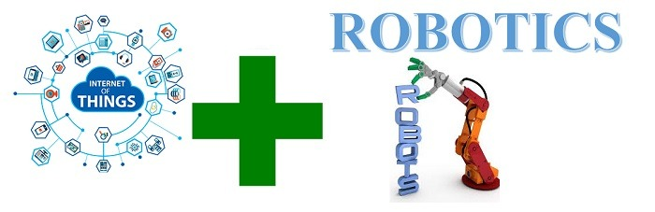
Internet of Robotic Things
Internet of Things + Robotics
“Smart devices to monitor events, gather data and exploit a local and distributed intelligence to control objects in the best way” [3].
Goals:
Overcome robotics issues (interoperability, computation, security).
Combine IoT technologies with robotic systems.
Provide intelligent and self-adaptive solutions.
Applications:
Disaster response, healthcare, agriculture, manufactories.
Smart cities, Industry 4.0.
[3] “The internet of robotic things”, ABI Research, p. 20, 2014.

Slide 5
IoRT Architecture
The IoRT Architecture can be divided into 3 layers like the ones in the OSI Model.
Service and Applications
Application protocols
Cloud computing
Machine learning
Network and Control
Communication protocols
Controllers
Cloud data storage
Physical
Robots
Sensors
Actuators

Slide 6
IoRT Protocol Stack
Layer | Protocols Applicable to IoRT | Usage
Application | CoAP, MQTT, REST API, XMPP, TLS | Data streaming
Transport | UDP, TCP | End-to-end communication
Network | IPv6 | Internet connection
Link | Wi-Fi, 802.15.4, Bluetooth, LoRaWAN, NB-IoT, Sigfox | Robot-to-Robot, Access Point, Gateway Communication
Physical | Robots, Sensors, Actuators | Data acquisition

Slide 7
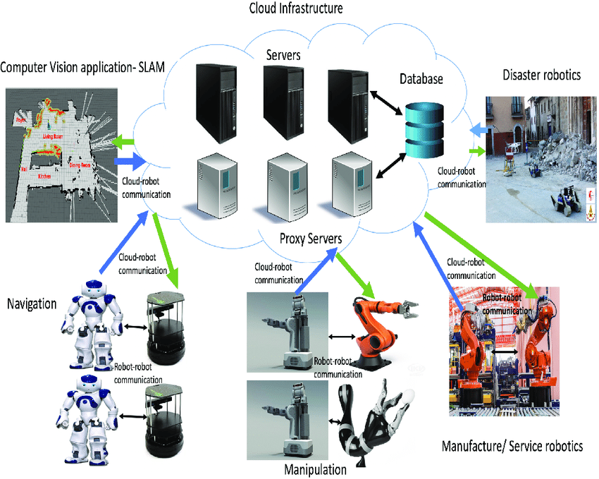
Other Key Elements
Cloud Robotics.
Machine Learning.
Reinforcement Learning.
Robot-Human Interaction.
Cloud Infrastructure [4]
[4] O. Saha and R. Dasgupta, “A comprehensive survey of recent trends in cloud robotics architectures and applications”, Robotics, vol. 7, August 2018.

Slide 8


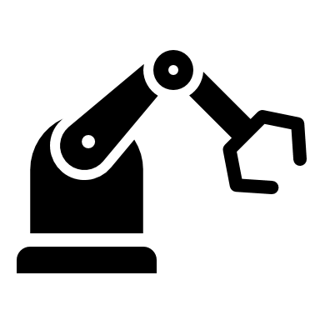

Application Domain: Disaster Response
Objectives: Help and assist rescue operations during a disaster response scenario.
Outputs: Enhance overall success rate of operations and survival rate of victims.
1. Sensory Data Collection
Remote : Cloud
Local : Workstation
Field : Robot
2. Model Training
3. Model Validation
4. Testing
Embedded
Deploy
IoT Data Recorder
IoT Data Recorder
Trained Model
[5] M. F. R. Lee and T. W. Chien, “Artificial intelligence and internet of things for robotic disaster response,” in 2020 International Conference on Advanced Robotics and Intelligent Systems (ARIS), August 2020.

Slide 9
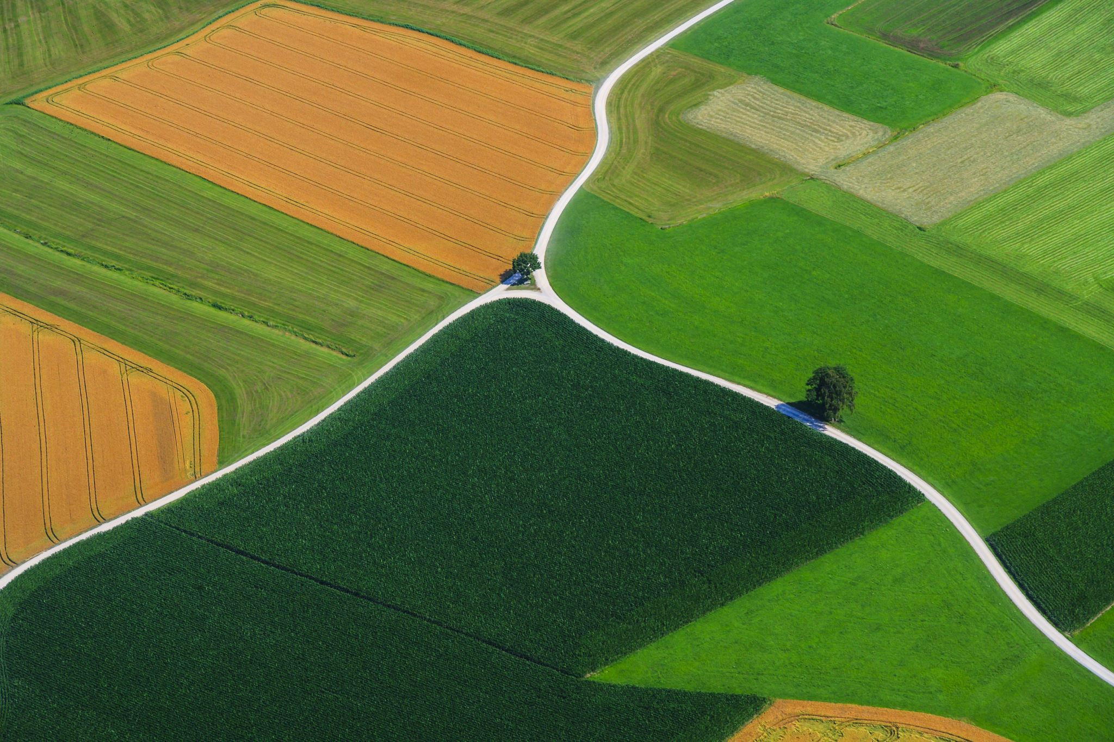
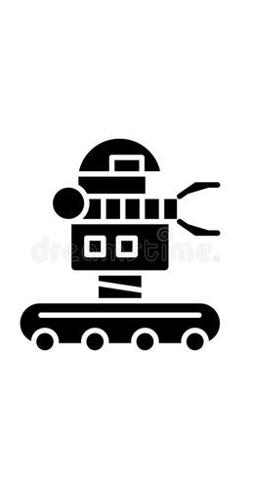
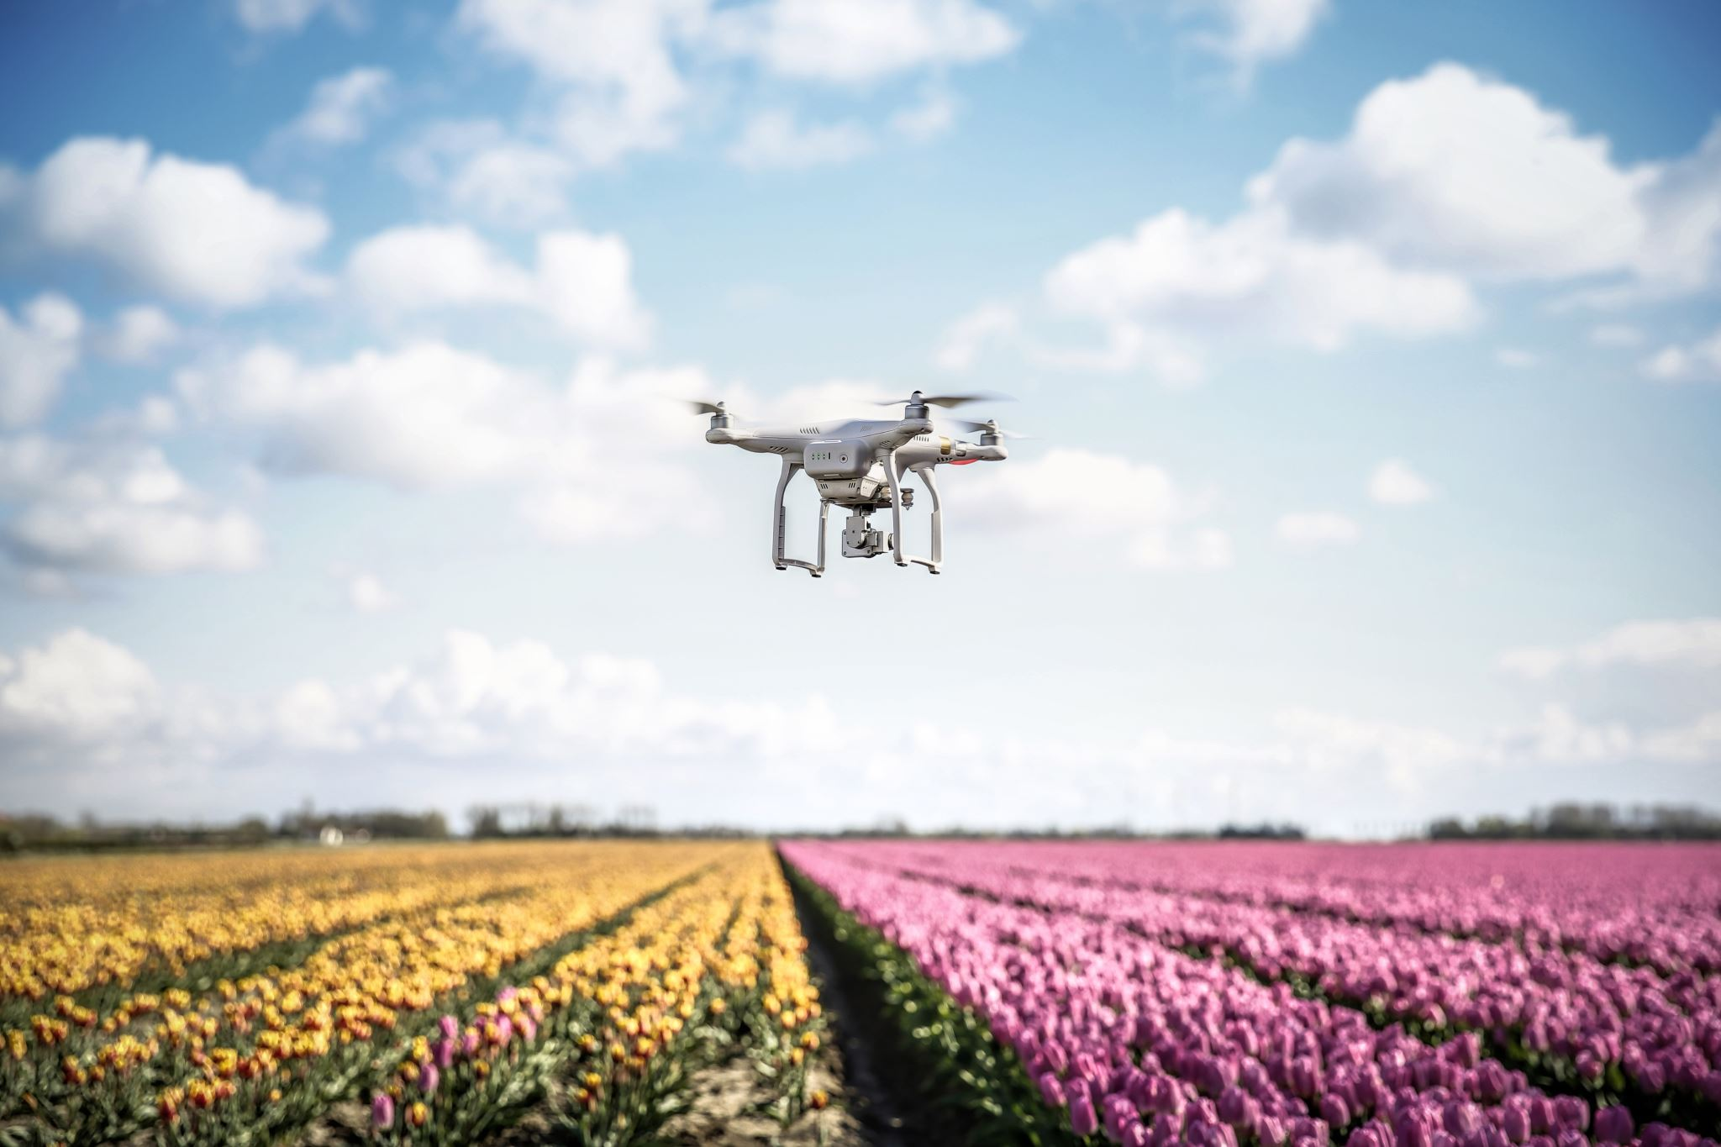

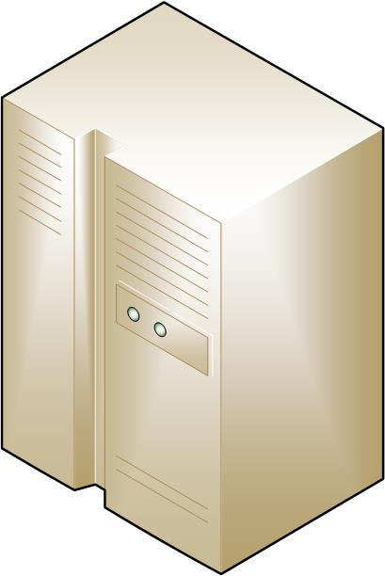

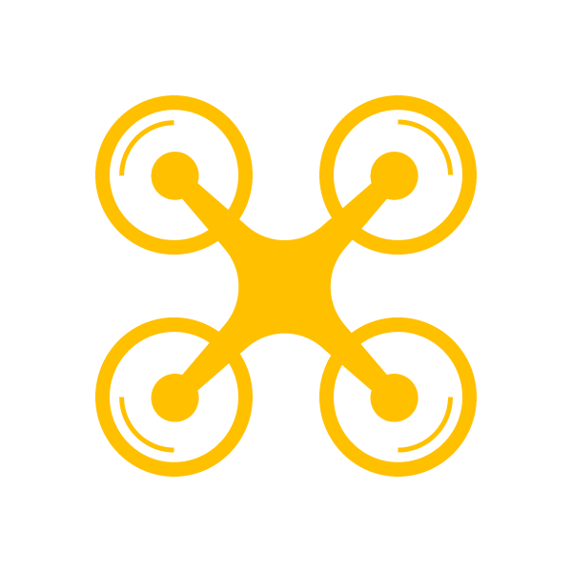

Application Domain: Precision Agriculture
Objectives: Develop appropriate agricultural plans during climate changes or hazard situations.
Outputs: Saving time and resources as well as increasing of the productivity.
Environment
Server
User
Data Acquisition
using Robots
HTTP: Websocket
Communication
Over
Wi-Fi Cellular
Back-End of the
Web Application
Front-End of the
Web Application
Browser
or
Application
[6] H. Durmus¸ and E. Gunes, “Integration of the mobile robot and internet of things to collect data from the agricultural fields,” in 8th International Conference on Agro-Geoinformatics, pp. 1–5, July 2019.

Slide 10
Technology Challenges
Data Processing:
High demand for processing massive data
Latency on real-time applications
Unreliable communication
Solutions
Efficient computing frameworks
New communication technologies
Optimization
Security & Safety:
Insecure communication
Authentication failure
Robot failures
Solutions
Secured communication
Strengthening authentication
Safety measures on robots
Notes:
Here we can mention the challenges in the use of the IoRT comprising: Data processing, Security and Safety. We could make a pointed list with a few words and some figure at the right if needed.

Slide 11

Ethical Issues
Robot ethic
Robots should benefit but not harm users.
Property rights
The origin and owner of information should be clarified.
Privacy
Data should be accessed only with proper permission and authorization.

Slide 12
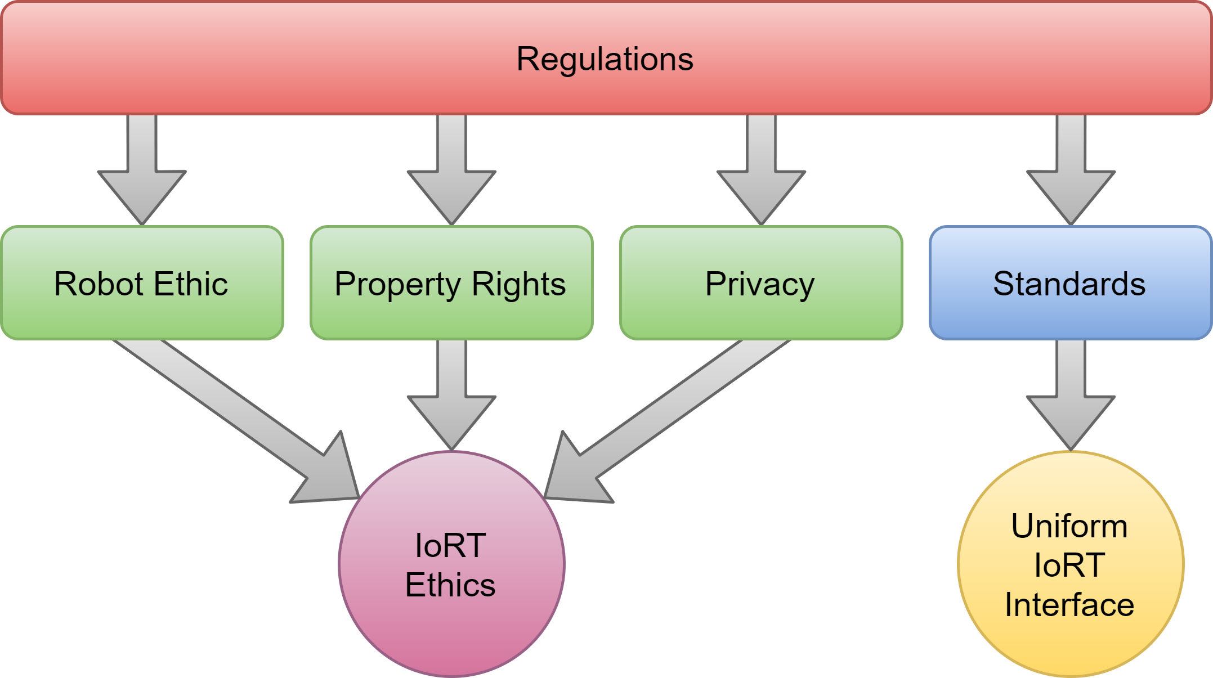
Regulations
No clear systematic regulatory framework specifically on IoRT.
Ethical and legal impacts: hard to determine the liability for incidents.
Technologies impacts: hard to integrate highly divisive devices.
Improving measures: issuing regulations and standards.

Slide 13
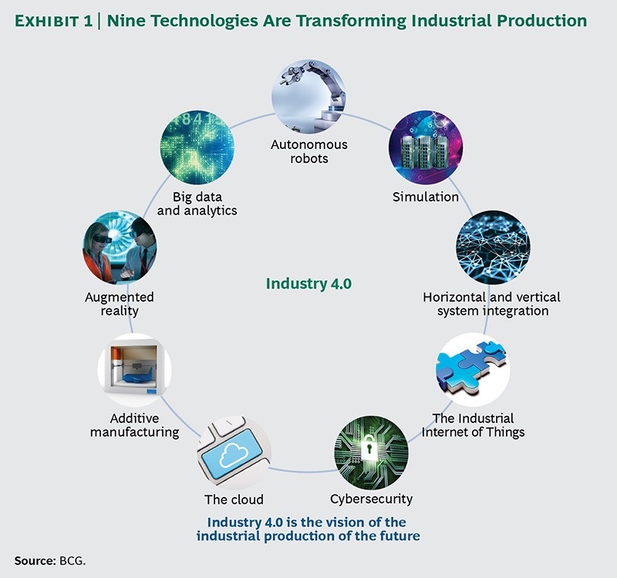
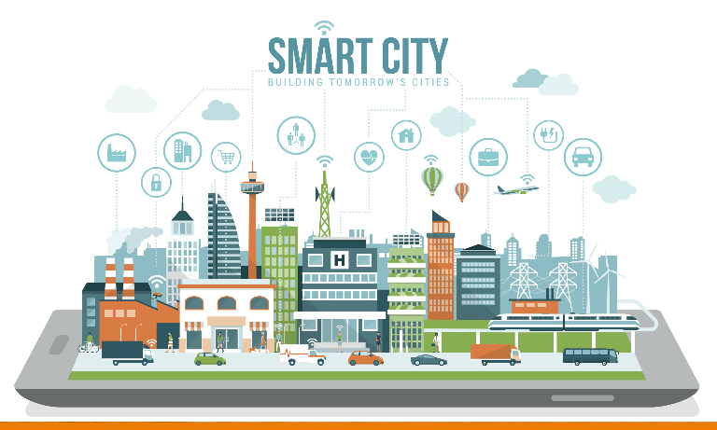
Conclusion
The IoRT combines the benefits of both IoT and robotics systems and stands as one of the key technologies to support the future smart society:
Smart manufacturing for Industry 4.0.
Smart city.
Notes:
Wrap up what we have presented with a pointed list and highlighting the motivation of this paper which is the awareness and research principles.

Slide 14
Thank you

Slide 15
References
[1] https://www.gartner.com/, November 2020.
[2] J. L. Fuller, Robotics. USA: Prentice Hall PTR, 2nd ed., 1998.
[3] “The internet of robotic things”, ABI Research, p. 20, 2014.
[4] O. Saha and R. Dasgupta, “A comprehensive survey of recent trends in cloud robotics architectures and applications”, Robotics, vol. 7, August 2018.
[5] M. F. R. Lee and T. W. Chien, “Artificial intelligence and internet of things for robotic disaster response,” in 2020 International Conference on Advanced Robotics and Intelligent Systems (ARIS), August 2020.
[6] H. Durmus¸ and E. Gunes, “Integration of the mobile robot and internet of things to collect data from the agricultural fields,” in 8th International Conference on Agro-Geoinformatics, pp. 1–5, July 2019.
[7] M.Rußmann et al.,“Industry 4.0: The future of productivity and growth in manufacturing industries,” April 2015.

